Slide 1
Globalight News Project
Name: Doğukan Şimşek Student ID: 190704902

Slide 2
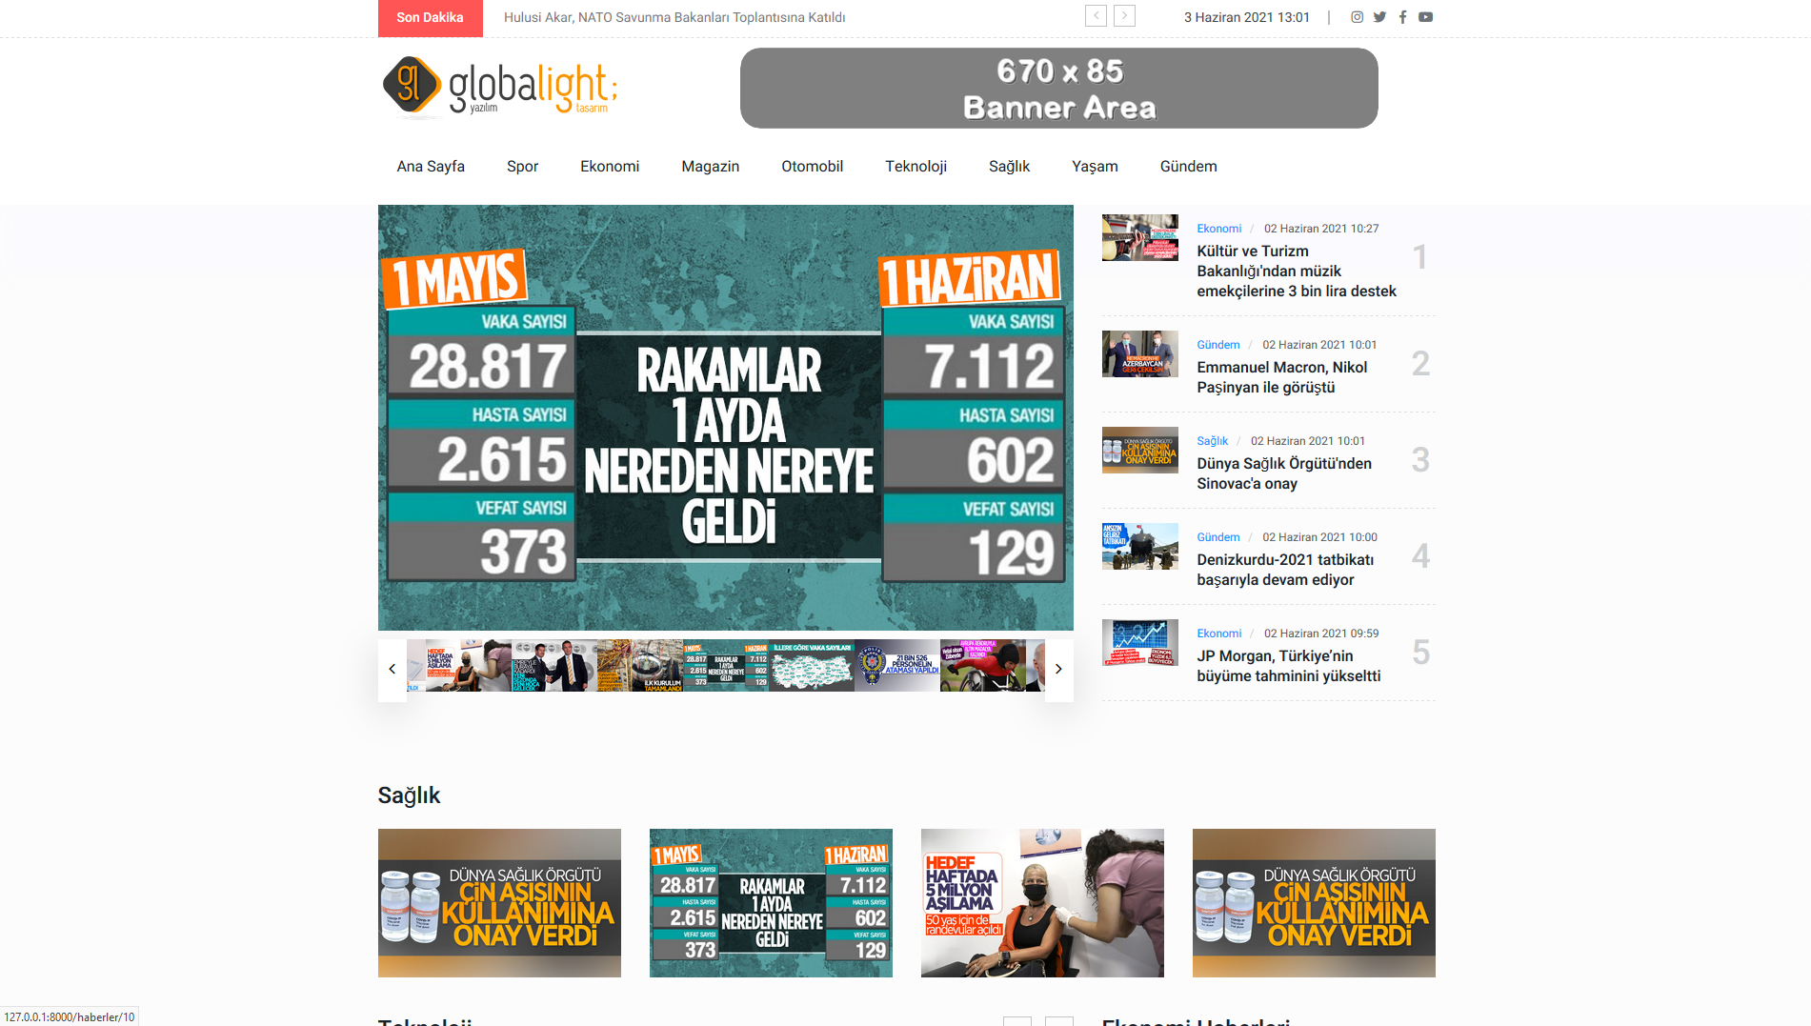
General Information
Our project was prepared with Python v3.9.5 and Django v3.2.3.
In our project, the SQLite database built into Django is used.
Our site generally works on 3 pages. Home, Category page, and News page.
These pages are template pages, and data is brought on the pages by the news or category called.
Different settings of the site such as Logo, Banner, Browser title are also dynamically adjusted.
Site: http://127.0.0.1:8000 Admin: http://127.0.0.1:8000/admin Test kullanıcı: test Password: Test123456

Slide 3
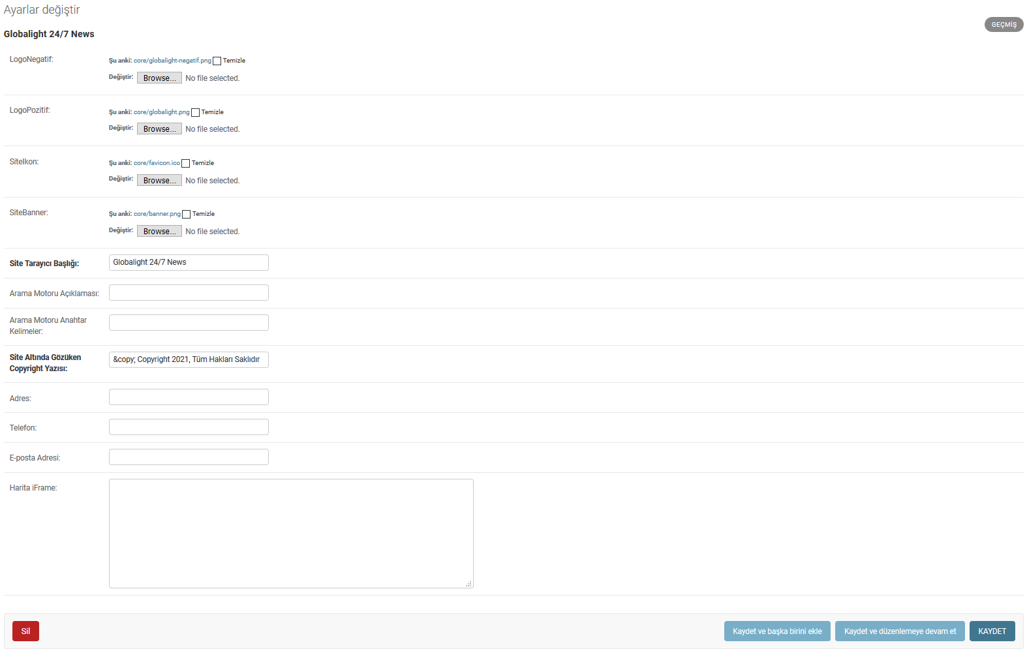
Settings
The page on which site settings are managed.
From this page, you can edit various settings such as browser title, logo, banner of the site.

Slide 4
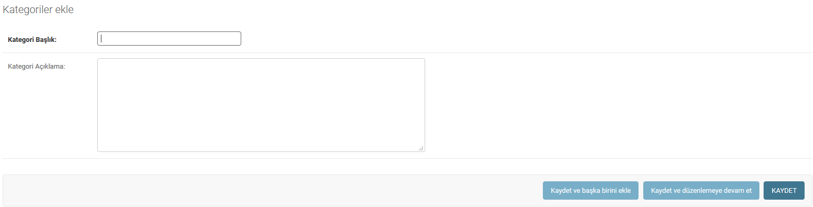
Categories
Categories:
1
Added from the Management panel
Admin:
2
It is dynamically generated and easy to manage. It can be deleted at any time.
3
News is created in a defined way to categories.
4
Each category has a dynamic page showing its own news. These pages are called through the template.

Slide 5
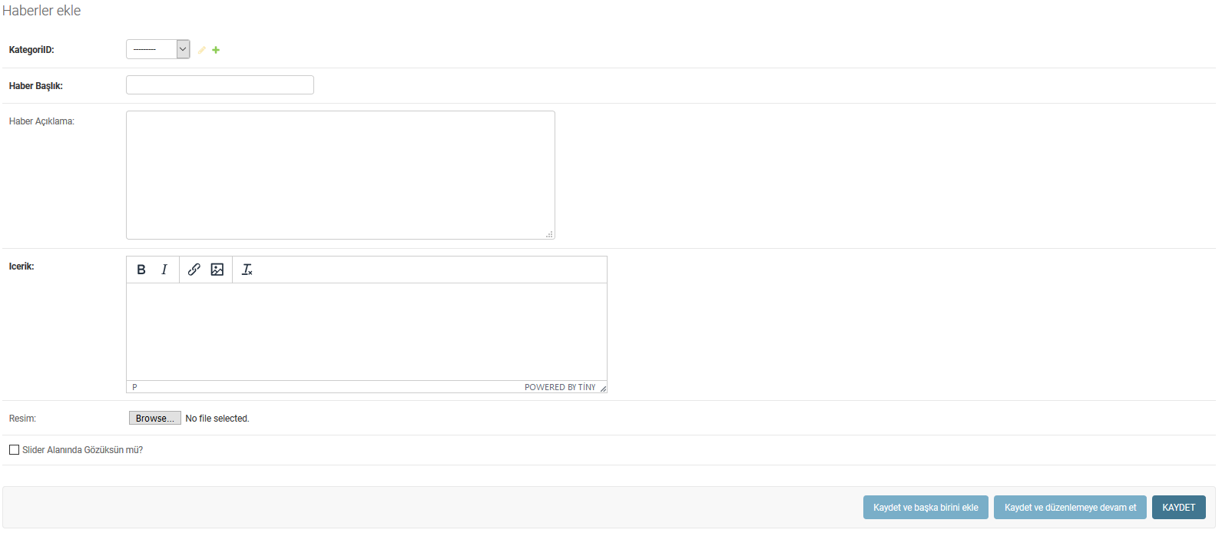
News
News:
Admin
1
All news of the site is entered from this screen.
2
You can assign the category you want to appear to by selecting it from the top.
3
If you want it to appear in the slider area on the homepage, should it appear in the Slider Area? You can mark the field.

Slide 6
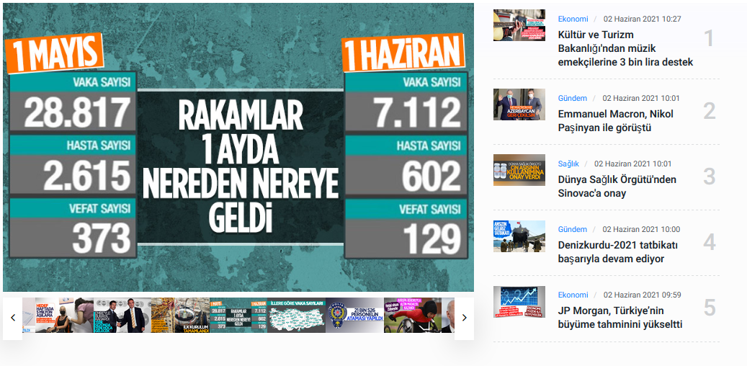

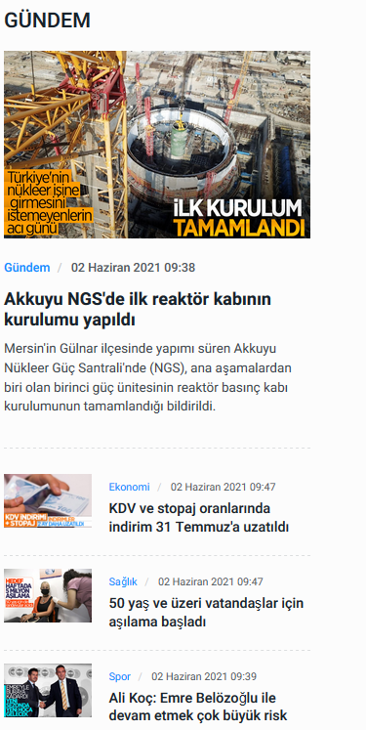
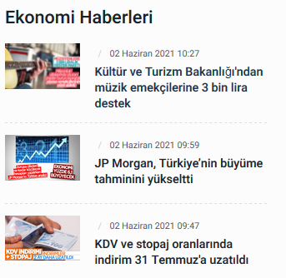
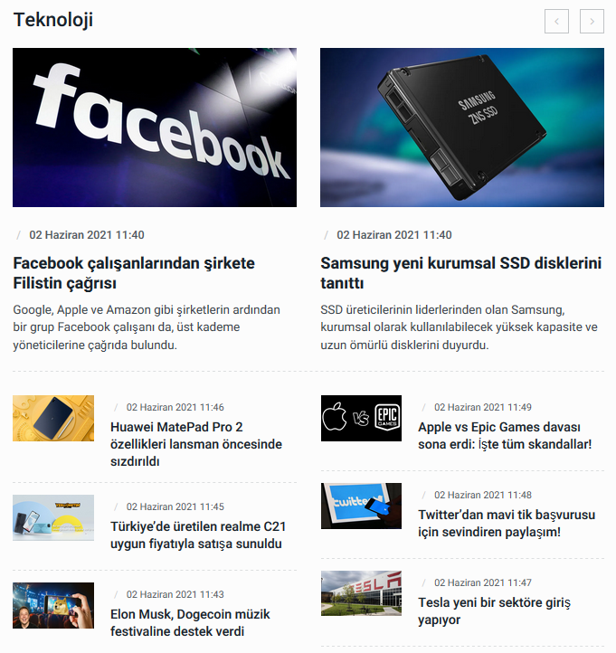
Miscellaneous News Areas

Slide 7
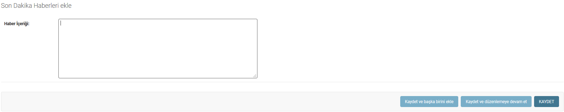
Breaking News
It is the area with breaking news at the top of the site:
Admin:
1
Entry is made from a separate area and is only a written information area.
2
If desired, a slight model change can be directed to a news story.

Slide 8
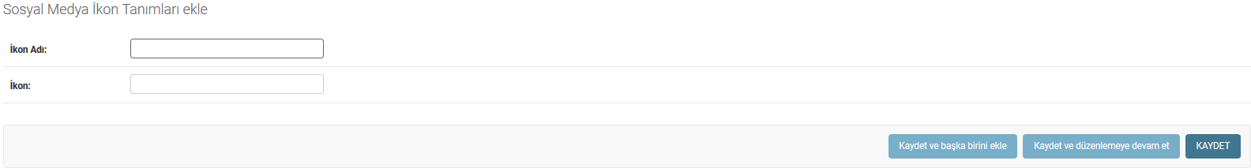
Social Media Icon Definitions
This field defines the icons of the social media accounts that you will define on your site:
Admin:
1
In order to define a social media account, icons must be defined here first.
2
Once icons are defined, you can add as many accounts as you want.

Slide 9
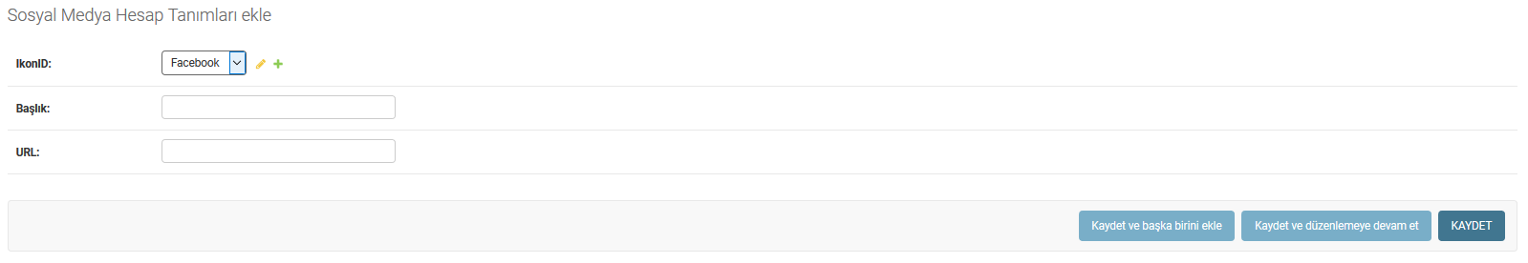
Social Media Account Descriptions
If social media icons are defined on your site, you can define a social media account. All you have to do is select the icon and type in the account address.
Admin:

